Slide 1
Integrated passive devices (IPD) for RF applications

Slide 2
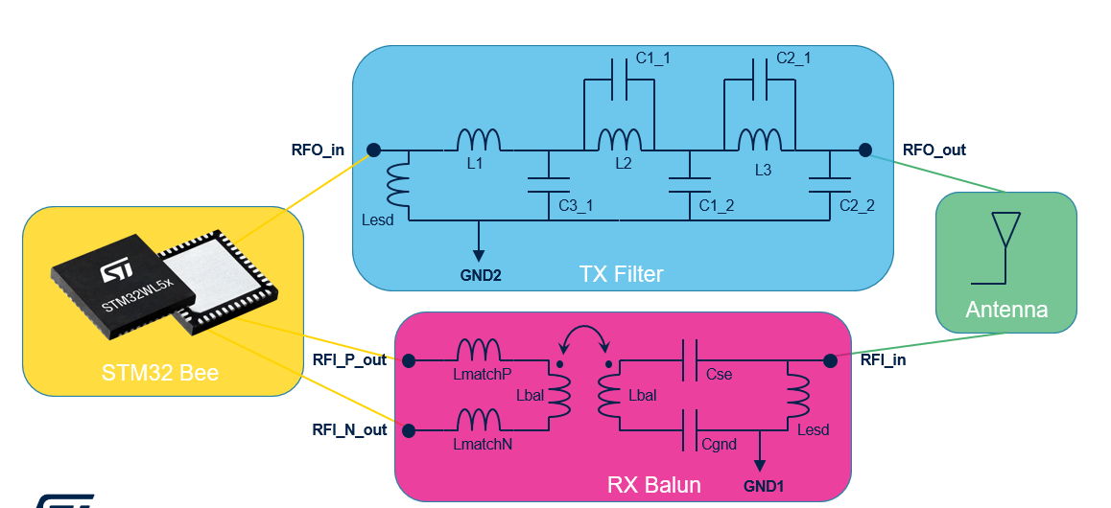
RF IPDs products companion chip to STM32WL5
9 IPD products
Developed to match all the STM32WL configuration (frequency bands, power level and package)
IPD die contain:
* Tx matching networks,
* Rx matching networks
* Balun
* harmonics filter
* ESD shunt inductor
IPD Die will replace 14 discreet L,C components and one balun, all in 3.8 mm²
STM32WL5
Benefits:
All in one: Matching , filtering, Balun and Antenna protection in one die
Designed to simplify RF path between STM32WL5 and Antenna
Optimized to answer optimized performances
BOM reduction, Reliability improvement
System integration: small die size of 1.8 x 2.13 mm²
IPD for STM32WL
1.8 x 2.13 mm² => 3.8 mm²

Slide 3
Choosing the RF IPD companion chip for STM32WL5
High-power mode
22 dBm
4-layer PCB
BALFHB-WL-01D3
BGA
Low-power mode
15 dBm
4-layer PCB
BALFHB-WL-04D3
High band
High-power mode
22 dBm
2-layer PCB
BALFHB-WL-03D3
4-layer PCB
BALFHB-WL-02D3
QFN
Low-power mode
15 dBm
4-layer PCB
BALFHB-WL-05D3
STM32WL5
2-layer PCB
BALFHB-WL-06D3
BGA
4-layer PCB
BALFLB-WL-07D3
Low band
2-layer PCB
BALFLB-WL-09D3
QFN
4-layer PCB
BALFLB-WL-08D3

Slide 4
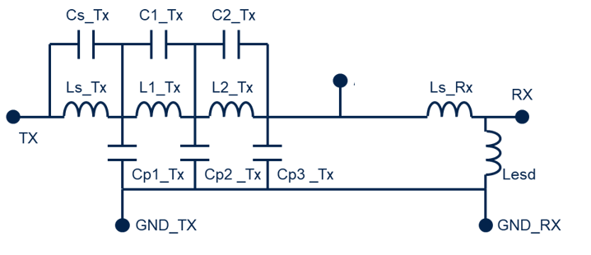
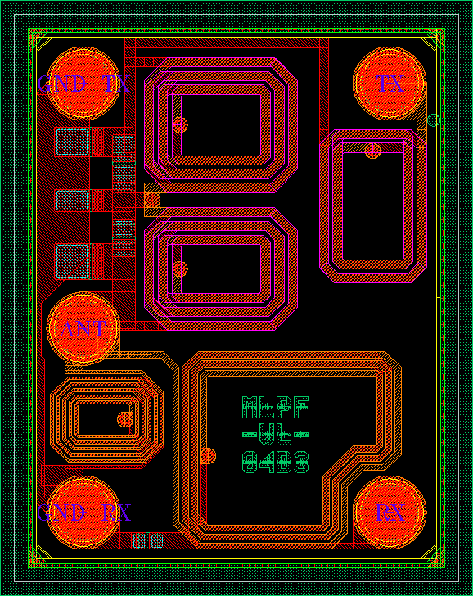
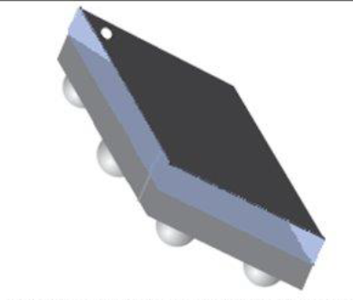
RF IPDs products companion chip to STM32WL3
Developed to match all the STM32WL3 configuration (frequency bands, power level)
IPD die contain:
* Tx matching networks,
* Rx matching networks
* harmonics filter
* ESD shunt inductor
IPD Die will replace 11 discreet L,C components and one balun, all in 2.9 mm²
STM32WL3
Benefits:
All in one: Matching , filtering and Antenna protection in one die
Designed to simplify RF path between STM32WBA and Antenna
Optimized to answer optimized performances
BOM reduction, Reliability improvement
System integration: small die size of 1.54 x 1.94 mm²
IPD for STM32WL3
2.9 mm²

Slide 5
RF IPDs products companion chip to STM32WL3 how to pick up the right one
4-layer PCB
MLPF-WL-01D3**
Low-power mode
16 dBm
2-layer PCB
MLPF-WL-05D3**
High band
QFN
4-layer PCB
MLPF-WL-02D3**
High-power mode
20 dBm
2-layer PCB
MLPF-WL-06D3**
STM32WL3
4-layer PCB
MLPF-WL-03D3*
Low-power mode
10 dBm
2-layer PCB
MLPF-WL-07D3**
Low band
QFN
4-layer PCB
MLPF-WL-04D3*
High-power mode
16 dBm
2-layer PCB
MLPF-WL-08D3**
* Qualification Q3 2024 ** Qualification Q4 2024

Slide 6
Find out more at www.st.com

