Slide 1
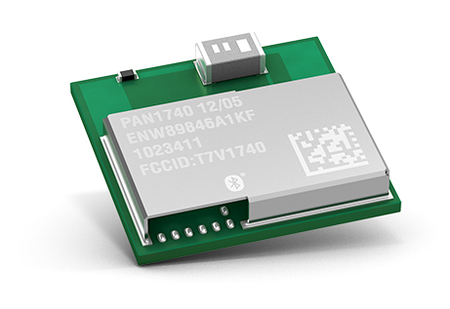
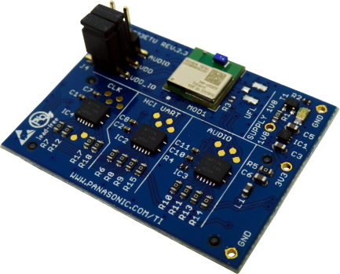


Panasonic Wireless Modules
IoT Partners for Industry 4.0
17th May, 2018
Dr. Chetan Joshi
Business Development Manager
Panasonic Industry Europe GmbH

Slide 2
Contents
Panasonic: An overview of the company
Why take the modular route?
Panasonic Wireless Connectivity portfolio
Development environments and tools

Slide 3
1
Panasonic: An overview of the company

Slide 4

Celebrating 100 years

Slide 5






Panasonic Industrial Devices Europe GmbH
2275 employees
6 locations
4 legal entities
4 countries
Lüneburg, DE
Established 1984
Head of site U.Bachsmann, T.Horio
Employees 270 (R&D 140)
Functions HQ, Development, FAE, Marketing
Stara Lubovna, SK
Established 1997
Head of site U.Bachsmann, S.Vojtas
Employees 540
Functions Production
Products Control boards, AMP, WM, DAB tuner
*Additional locations in:
Pfaffenhofen(GER), Plana(CZ), Enns(AT), Trstena(SK)

Slide 6

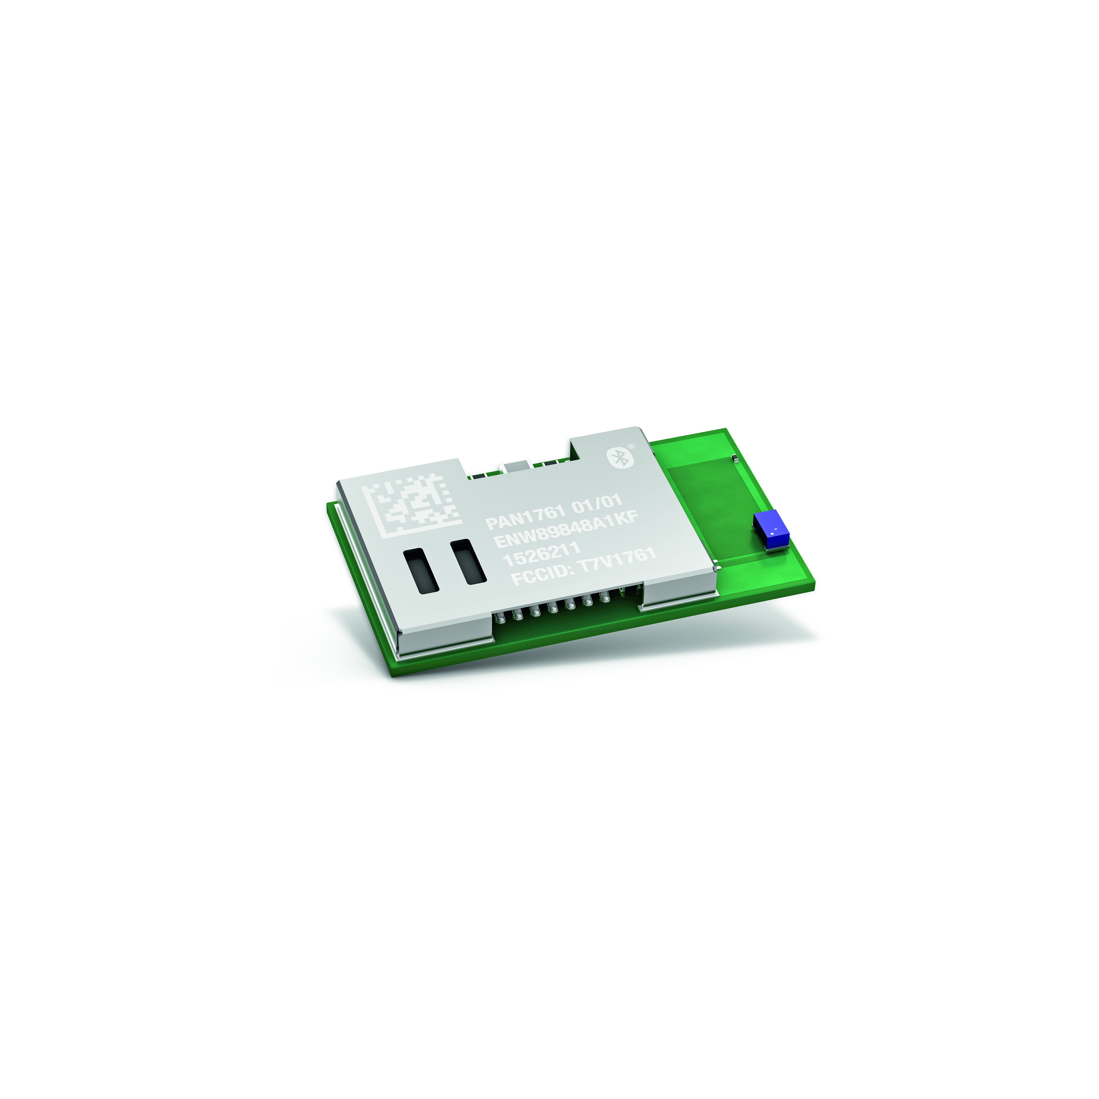
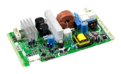
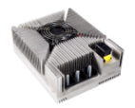
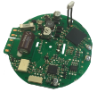



Product Portfolio @ PIDEU
Wireless Modules
Motor Controls
DCDC Converter
Power Supplies
Bluetooth Classic, Low Energy or Combo Modules
Wi-Fi Embedded or Wi-Fi Radio
Fully qualified and certified
Customized modules
Brushless DC , Universal or Switched Reluctance
Up to 3 kW
High / Low voltage drive
Sensor/sensor less motor drive
Up to 3000 W
Convection: passive air/ forced air cooling
CAN & LIN interface
1000 W/L power density
Up to 230 V AC 3,0 kW
High / Low voltage drive
High Efficiency >95%
Inverter
BMS
HMI
Charger
From 6 W to 5000 W
DC/EC or AC/EC technology
High efficiency EEI < 0,20
1 to 3 phase current
(AC 100V/230 / 400 V)
Sensor or sensor less control
Fan motor & EEV drive
Four way valve
8 Bit to 32 Bit Controller
Embedded operating system on customer demand
Service interface with cable or wireless communication
GUI Design / Surface Design
Audio Output / Voice Input
NiMh, Lead Acid, Lithium Ion
100 W - 3000 W
Service Charger
Ultra fast charging algorithm
IP Protection
Wall mounting
Up to 16S battery pack
On board charger
Different sleep modes
Battery cell balancing
Single cell monitoring
Standard products available through Avnet

Slide 7
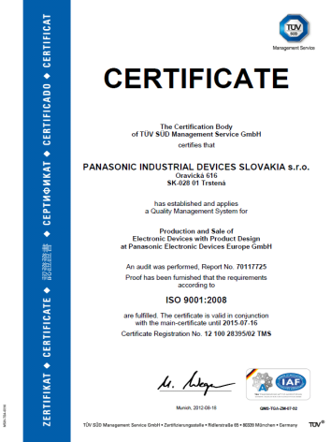

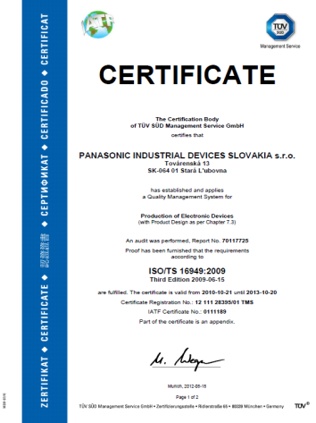








PIDEU System Certifications
ISO 9001
Certified in 1993
ISO 14001
Certified in 1999
ISO/TS 16949
Certified in 2007
ISO/IEC 27001
Certified in 2008
Product safety
Certifications

Slide 8
2
Why take the modular route with Panasonic?

Slide 9






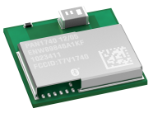
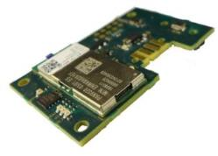
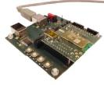
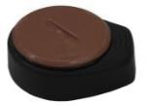
Benefits of the Panasonic Modular Solutions
Economical vis à vis chip solutions
Certifications
QDID
BT SIG
Europe
USA
Break-Even between
80k – 250k
Price
South Korea*
Japan*
Canada
Units
*not available for all modules
 | Benefits
RF Design | RF team needs less board design iterations | ü
Size | Saves board area | ü
Procurement | Reduced operational costs | ü
Assembly | Reduced production costs | ü
Test | Reduced production costs | ü
Quality | Increased quality | ü
Yield Loss | Reduced production cost | ü
a.
b.
c.
Engineering & Production benefits
Cooperation Models

Slide 10
Panasonic’s Customised Solutions Competencies
One-Stop-Shop to the Customer
Service
Consultation & Solutions
Support
Sales, FAE, Engineering, Partner, Supplier
Software
Linux Expertise, Firmware, Reference Code, Demoware
Hardware
Standard, Customized, Solutions, Evaluation, Demoware

Slide 11
3
Panasonic Wireless Connectivity Portfolio

Slide 12






Wireless Connectivity : Standard Products
Wireless modules for short range communications
2005
2018
/802.15.4

Slide 13


Slide 14
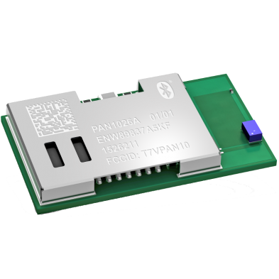
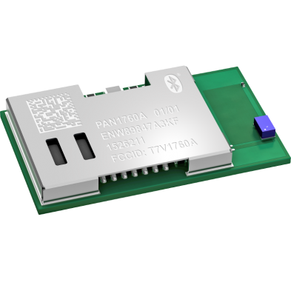
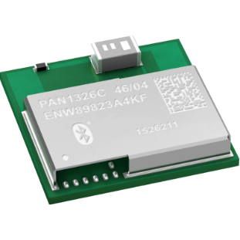

Wireless Connectivity : Bluetooth Lineup
PAN 1026A
PAN 1760A
Dual Mode
Low Energy
PAN 1326B/C
PAN 1740

Slide 15
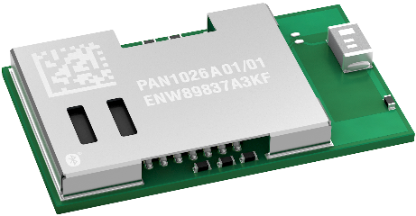

Bluetooth Dual Mode : PAN1026A
Highly popular ready-to-use module, ideal for cable replacement applications
Based on Toshiba TC35661
BT 2.1 embedded SPP profile/ BT 4.2 embedded GATT
Small form factor: 15.6 x 8.9 x 1.8 (in mm)
AT command like interface
Pin to Pin compatible with PAN1322/PAN 1026
Ordering details: ENW89837A5KF
Processor | ARM7
Software Profile | Toshiba SDK
Antenna | Ceramic
BR + LE

Slide 16
Bluetooth Dual Mode : PAN1326 B/C
Low-cost compact HCI Module: leveraging full possibilities of Bluetooth
Based on highly popular Texas Instruments cc2564 -/c
Bluetooth Classic + Low energy
Supports multiple Bluetooth classic profiles (including audio.)
Very compact design (9.0 x 9.5 x 1.8 (in mm))
Antenna less versions (with bottom pad) available.
Ordering details: ENW89823A3KF/ENW89823A4KF
Processor | Host controllerd
Software Profile | Texas Instruments, Open Synergy
Antenna | Bottom pad/ Ceramic
BR + LE

Slide 17
Bluetooth Dual Mode : Comparison
 | PAN1026A | PAN1326B/C
Integration level | BT 2.1 embedded SPP profile BT 4.2 embedded GATT | HCI
Output Power | +4 dBm | +10/12 dBm
Stack | Toshiba SDK | Texas Instruments SDK
Form factor (mm) | 15.6 x 8.7 x 1.8 | 9.0 x 9.5 x 1.8
Applications | Cable Replacement Wireless Sensors Monitoring and Control | Consumer Electronics Medical Monitoring and Control

Slide 18
Bluetooth Low Energy : PAN 1740
Compact BLE 4.2 for Standalone applications: Cortex M0 + OTP
Based on Dialog Semiconductor’s DA14580
Great choice for small standalone IoT nodes
Very Small form factor of 9.0 x 9.5 x 1.8 [mm]
Low power consumption (4.9mA Tx)
Beacon reference available
Ordering details: ENW89846A1KF
Processor | ARM Cortex-M0
Software Profile | Dialog SDK
Antenna | Ceramic
Memory | 32 kB OTP 42 kB SRAM
LE

Slide 19
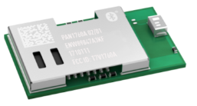
Bluetooth Low Energy : PAN 1760A
Ultra Low Power consumption BLE 4.2: Big Flash & RAM with a Cortex M0
Based on Toshiba’s TC35678: mandatory & optional features of BLE 4.2
Industry’s first ultra low power BLE 4.2 : 3.3 mA peak Rx/Tx
Cortex M0 optimized for standalone applications
192 kB RAM, of which 83 kB available for user application
Huge flash storage 256 kB
AT Command mode to access full functionality of module
Ordering details: ENW89847A3KF
Processor | ARM Cortex-M0
Software Profile | Toshiba SDK
Antenna | Ceramic
Memory | 256 kB Flash 192 kB RAM
LE

Slide 20
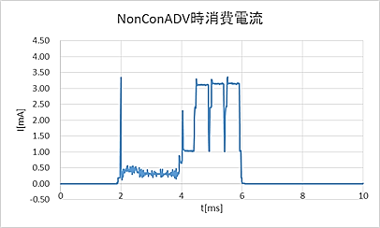

Bluetooth Low Energy : PAN1760A
Industry’s leading ultra low power consumption BLE module
Advertising
Advertising: 1 sec interval
Battery (CR2032): 225 mAh
Average current: 8.5 µA
Battery life time: 3 years !
TX:3.3mA peak current
LE

Slide 21
Bluetooth Low Energy : Comparison
 | PAN1740 | PAN1760A
Bluetooth | Bluetooth LE 4.2 Core | Bluetooth 4.2 (Core+Optional) Secure Connection Increased MTU size
Output Power | 0 dBm | 0 dBm
Stack | Dialog SDK | Toshiba SDK
Form factor (mm) | 9.0 x 9.5 x 1.8 | 15.6 x 8.7 x 1.8
Memory | 32 kB OTP | 256 kB Flash, OTA possible.

Slide 22
Bluetooth Low Energy : Ready today
PAN1760A supports Bluetooth SIG Certified Mesh 1.0 Stack

Slide 23
Bluetooth Low Energy : Ready this summer
5.0
Bluetooth 5
PAN1760B
Long Range/2Mbps/enhanced advertising
Bluetooth 4.2
PAN1760A
Samples
Mid 2018
Pin and footprint compabitle
Based on same SDK
Today
Easy migration path between different modules

Slide 25
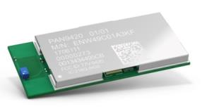
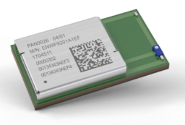
Wireless Connectivity : WiFi Lineup
Embedded 802.11n module
Panasonic Stack for zero hassles WiFi Connectivity
Host controlled - 802.11 a/n module
& Bluetooth 5.0*
* Core features

Slide 26
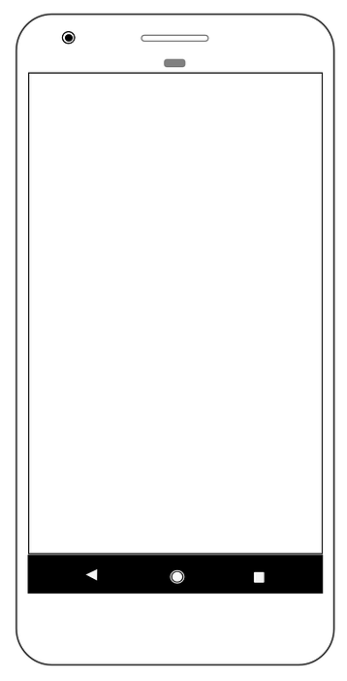
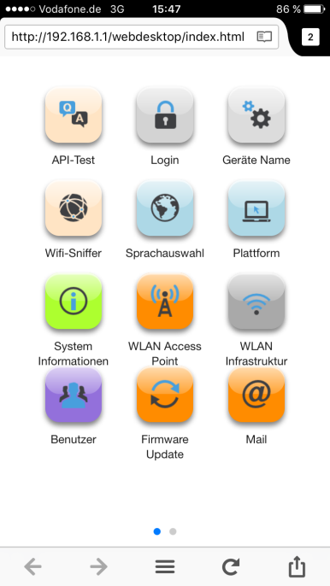
Wi-Fi : PAN 9420
Place & Play Wi-Fi – Roll out your IoT Product in a few hours!
Fully certified embedded solution for optimizing cost and time-to-market
AT Commands driven Panasonic WiFi stack for stand-alone applications
Takes care of security: WPA2, WEP, TLS1.2/SSL, X.509
AES encryption for data on UART
2 MB User Space on the module for HTML Application Data
Easy cloud connectivity with MQTT Client
Support for WiFi direct, simultaneous AP and STA mode
Ordering details: ENW49C02A3KF (CE Version)

Slide 27









Wi-Fi : PAN 9420’s Simultaneous AP & STA
Benefit of Simultaneous Access-Point & Infrastructure Mode
Access Point - Mode
Station –
Mode

Slide 28

Wi-Fi : PAN 9026
High throughput WiFi & Bluetooth in a highly compact package
Host Controlled Wi-Fi 2.4 / 5 GHz 802.11 a/b/g/n
Highly compact design: 17 x 10 x 2.0 (in mm)
SDIO/HS UART interfaces for upto 150 Mbps PHY speeds
Integrated switch for using onboard antenna/ bottom pad
Simultaneous support of Access-Point & Infrastructure Mode
Concurrent and independent operation of WiFi & Bluetooth
Supports Bluetooth 5.0 core features
Ordering details: ENWF9201A1EF (CE Version)
+
BR + LE

Slide 29


Slide 30
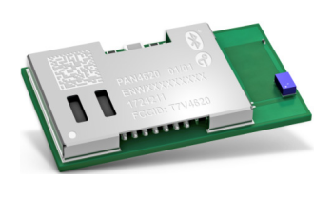




Thread / ZigBee + Bluetooth Low Energy: PAN4620
Designed for IoT applications without the need of a gateway
IEEE® 802.15.4 and Bluetooth Low Energy 4.2
Single or concurrent operation of Thread/ZigBee and BLE
Host-mode or Standalone-mode possible
512 kB flash memory and 128 kB SRAM
Application layers like dotdot, IoTivity, OpenDOF can be used
+
LE

Slide 31
4
Development Environment & Tools

Slide 32
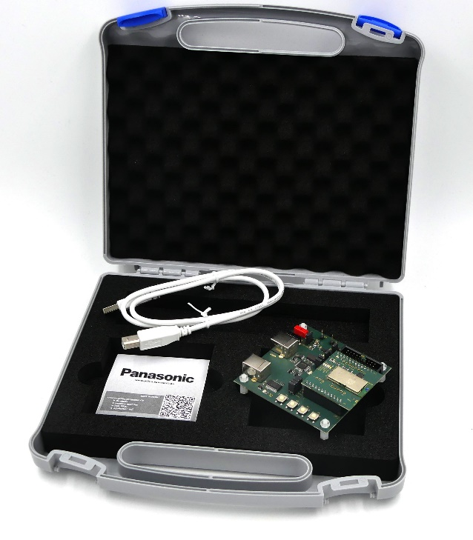
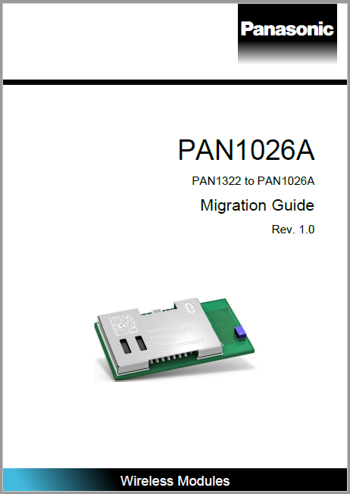
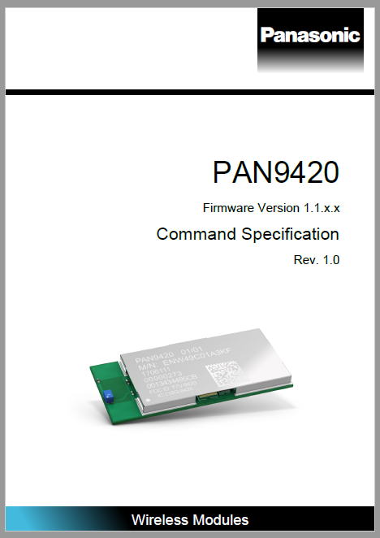
How to get started?
Hardware
Software
Evaluation kits and samples available
Well documented SDK’s and AT command specification sheets.

Slide 33



Software
Ease of use with SDK’s & Documentation
AT Command documentation

Slide 34
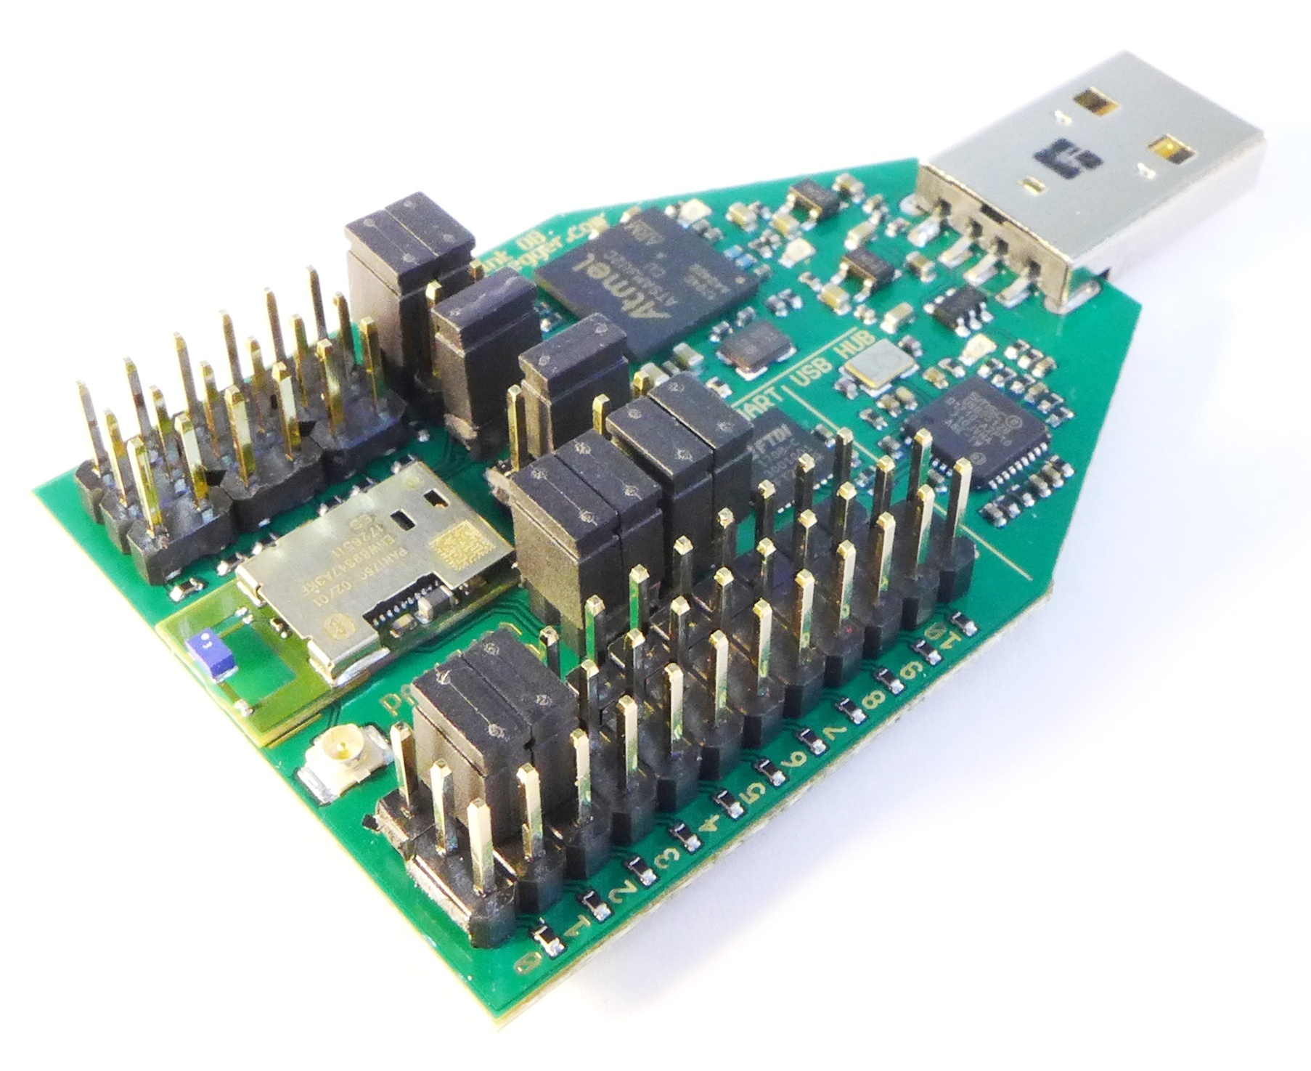
PAN1760A Evaluation kit
Rapid prototyping of Bluetooth standalone projects
Simple to use pair of USB sticks
User guides & sample implementations of various BLE profiles.
Ideal for quick debug & testing of host mode & standalone projects.
Ordering details: ENW89847AWKF

Slide 35

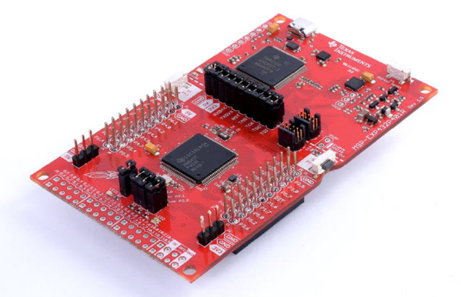
PAN1326 B/C Evaluation kit
Evaluation kit and Open Synergy’s Blue SDK
Ordering details: ENW89819AYKF
MSP430 Launch Pad + Adapterboard + PAN1326C ETU
Adapterboard comes with crystal soldered.
Cooperation with OpenSynergy - Blue SDK
Panasonic company since 2016
Market-leading Bluetooth stack for automotive
Deployed over 1 Billion units
Use any microcontroller
High stability and robustness of the code
Interoperability of stack and profiles
Support of practically every Bluetooth Use-Case
Business model direct or via Panasonic

Slide 36

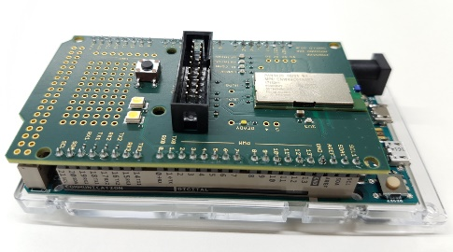
PAN 9420 Evaluation Kits
Rapid prototyping for quickest time to market
Experimenter’s kit with main and daughter boards.
FCC version of the daughterboard comes preflashed with firmware for ioT applications.
Simple graphical interface to test ASCII based commands.
Ordering details: ENW49C01AYKF
Also available soon: Arduino DUE Shield ready to connect to IBM Watson Bluemix cloud.

Slide 37
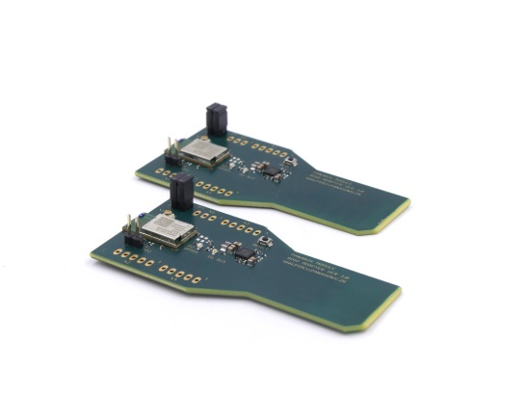
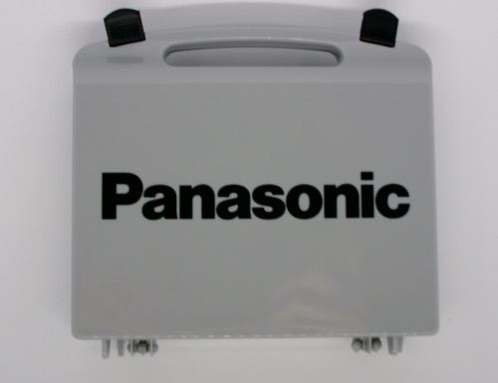
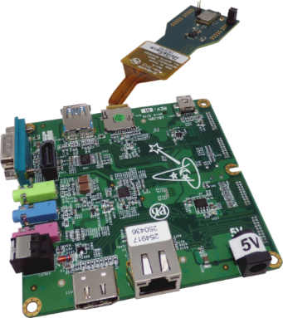
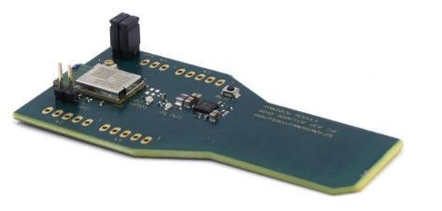
PAN 9026 Evaluation Kit
WiFi Bluetooth SDIO ETU with Cortex A9 i.MX6
PAN9026 SDIO Dongle
Kit with Cortex-A9 board - Freescale i.MX6
Quick start kit and sample software under preparation
Ordering details: ENWF9201AYEF

Slide 38
…in conclusion

Slide 39

Long lasting partnerships with IC supplier and software provider
Single Window Support
Solutions from scratch
Reliability and Availability
European Product
Business Model Flexibility
Samples
Fast decision making
Easy-to-use
Evaluation kits
Product specific features
Certifications: CE, FCC, IC

Slide 40
Q&A

Slide 41
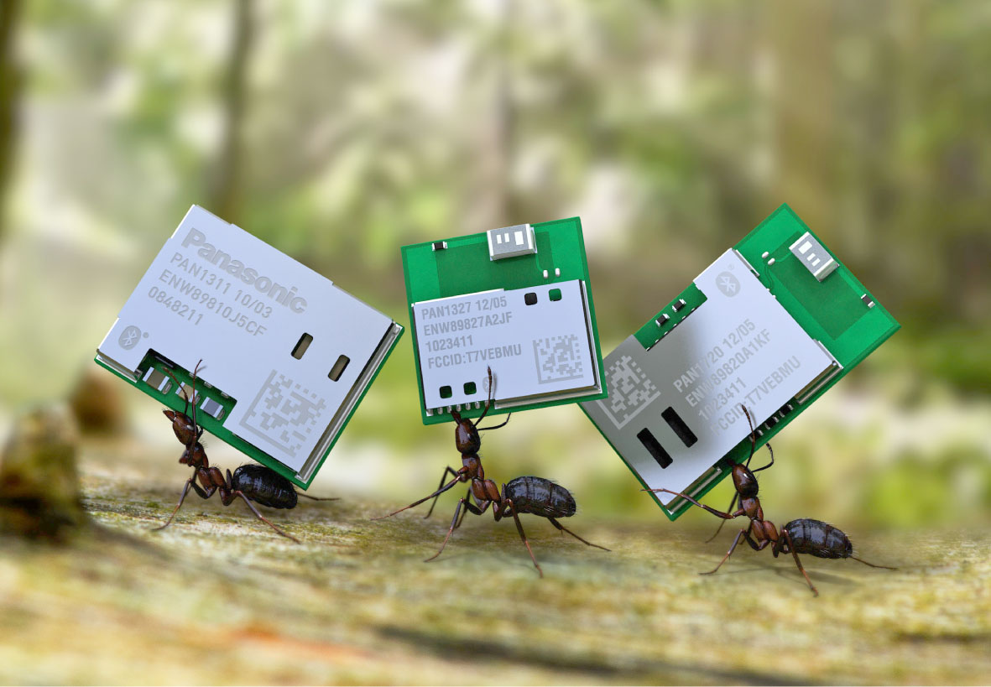
Thank you!

